Slide 1


Distinguishable INNs: A Global Solution
Richard Dolinar, MD
Chairman, Alliance for Safe Biologic Medicines
Presented at the 58th Consultation on
International Nonproprietary Names for Pharmaceutical Substances
Geneva, Switzerland
April 8, 2014

Slide 2
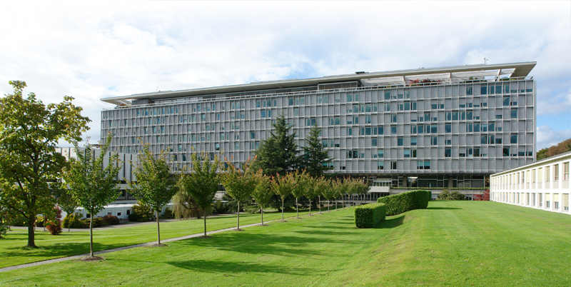
ASBM Presented at the 57th Consultations on INN
Open Session for Stakeholders – October 22, 2013
Out of that meeting came a charge to look into a distinguishable naming system, including a BIOLOGICAL QUALIFIER.
A global coding system of shared root and identifier assigned by INN Secretariat to ensure unambiguous identification.
“BQ appeared acceptable to the INN Expert Group, would help link a biosimilar to its reference product and to other biosimilars, which in turn would contribute to decreased mis-prescribing and improved pharmacovigilance”.
-Executive Summary,
57th Consultation on International
Nonproprietary Names for Pharmaceutical
Substances Geneva, 22-24 October 2013

Slide 3
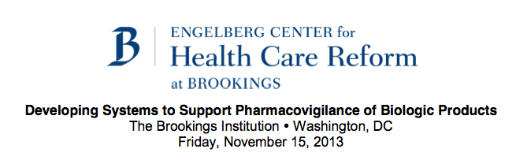
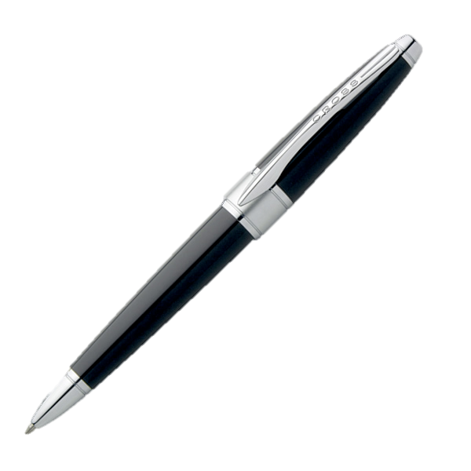
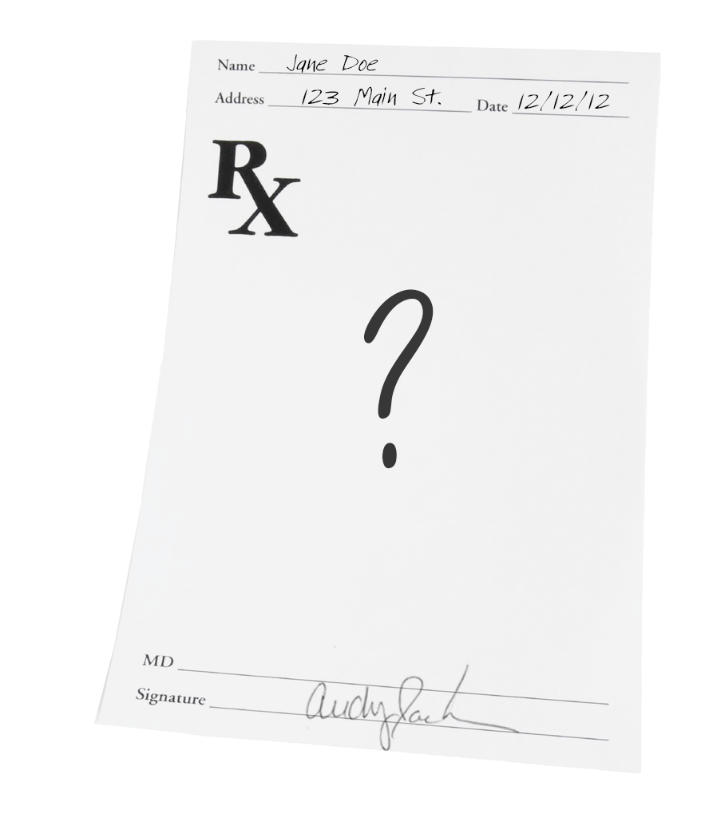
Since October, ASBM Has Been Doing Its Homework…
October 22, 2013
ASBM Presents at 58th INN Consultation
November 15, 2013
Participated at Forum at Brookings Institution in Washington DC.
OCT NOV DEC JAN FEB MAR
October-November 2013
European Prescriber Survey
Conducted by Industry Standard Research
March 18, 2014
European Prescriber Survey
Results Released in Brussels

Slide 4

ASBM Continues to Be Contacted By People Around The World Who Wish To Learn More About Biosimilars…
Edmonton, Canada
United Kingdom
Netherlands
Brussels, Belgium
Versailles, France
Dusseldorf, Germany
Madrid, Spain
Ankara, Turkey
Porto, Portugal
Msida, Malta
Kunming, China
Madras, India
Venezuela
Brazil
South Africa
Notes:
Prioritizing Patient Safety
In contrast to most medicines that are chemically synthesized and have structures that are known, biologics are complex
compounds made from living cells and have highly complex structures that are not easily understood, characterized or
replicated. That is why the attempts to replicate biologics are called biosimilar and not generics. Biosimilars are “similar to”
but not exact copies of biologics and small differences can have unexpected or harmful clinical outcomes for patients. While
the ultimate goal is to find a balance between producing economical medicines and respecting the drug-discovery process,
patient safety should be paramount.
Leveraging What We Know
The European Union began to establish the first formal regulatory pathway for biosimilars in 2003, and that process can
serve as a baseline model for the U.S. to improve on. By pioneering in this regulatory area for the last 8 years, the E.U.
has gathered much data which can, at a minimum, help inform our own policy makers. We should take advantage of the
opportunity to learn from their experiences, both positive and negative.
Promoting Pharmacovigilance
Pharmacovigilance is the surveillance of a drug’s performance, particularly of adverse reactions, after it has been released
for marketing. Because biosimilars could be approved on less data than other medicines, pharmacovigilance is extra
important. Before biosimilars are introduced into the U.S. market, a robust traceability system (including distinctive labels,
product tracking codes, and a way to report adverse events) must be in place to ensure accurate surveillance.
Keeping Doctors Relevant
Doctors and patients should be able to carefully choose the best course of treatment rather than have legislators and regulators
decide for them. The path the government decides to pursue in approving biosimilars should reinforce this principle.

Slide 5
How Distinguishable INNs Aid in Pharmacovigilance
IDENTIFICATION
Patients, physicians, and pharmacists should be able to accurately identify the product, ensure it is the intended prescription, and avoid inadvertent substitution.
A biosimilar should be distinguishable both from its reference product and from other approved biosimilars which reference the same biologic.
PHARMACOVIGILANCE
Distinguishable naming helps differentiate products for observing and reporting adverse events.
Track and trace of biologics is more challenging than with chemical drugs. Adverse impact may go unrecognized in patients for months.
Multiple means of product identification avoid a single point of information failure.
MANUFACTURER ACCOUNTABILITY
Patient response must be traced to the correct manufacturer’s product.

Slide 6




Support for the Biological Qualifier among NRAs
MUCH PROGRESS HAS BEEN MADE TOWARD A SOLUTION THAT WORKS FOR DOCTORS AND PATIENTS :
Proposal has the support of representatives from Japan and Australia, which have or are developing their own BQ standards, but expressed willingness to conform with the global standard.
EMA did not rule out the use of a biological qualifier.
FDA has indicated its support for distinguishable names, as in the case of tbo-filgrastim, but have not issued any formal policy for biosimilar naming.
✓
✓

Slide 7
European Physicians and Patients
Will Benefit From Distinguishable INNs

Slide 8
European Prescriber Survey
First large-scale survey on biosimilars in Europe.
Examined physician knowledge and prescribing practices.
15-Minute Web-based Survey
470 Prescribers distributed equally between 5 countries in Western Europe:
  France
  Germany
  Italy
  Spain
  United Kingdom
Roughly equal distribution between six specialties in which biologics are frequently prescribed.
Conducted by Industry Standard Research, October-November 2013

Slide 9
Survey Identified A Need for Education…
and for Clear Naming of Biologic Medicines.
Both physician misconceptions about biosimilars, prescribing and AE reporting practices in Europe underscore a need for a clear naming system with distinguishable nonproprietary names for all biologics, including biosimilars, to facilitate intended prescribing and traceability.
EVEN where biosimilars have been available longest, AND a system for tracking exists, providers strongly support distinguishable names for ALL biologics.

Slide 10
European Prescriber Survey
Same Non-proprietary Name = Structurally Identical?
“If two medicines have the same non-proprietary scientific name, does this suggest to you or imply that the medicines are structurally identical?” (N=470)
53% of respondents mistakenly believe biosimilars with identical non-proprietary name as its reference biologic is structurally identical to that reference biologic.

Slide 11
This is Consistent With ASBM’s findings in its 2012
Survey of U.S. Physicians:
Identical Naming = Structurally Identical?
Source: ISR Survey of 376 U.S. Prescribers, August 2012

Slide 12
European Prescriber Survey
Same Non-proprietary name = Same Indications?
“If two medicines have the same non-proprietary scientific name, does this suggest to you or imply that the medicines are approved for the same indications?” (N=470)
61% of respondents believe biosimilars with an identical non-proprietary name as its reference biologic is approved for the same indications, which may not be the case.

Slide 13
European Prescriber Survey
Identifying Biologic Medicines in Patient Record
Only 32% of respondents use brand name and non-proprietary name (INN) to identify the exact biologic being prescribed.
24% use INN only, which could result in patients receiving the wrong medicine.

Slide 14

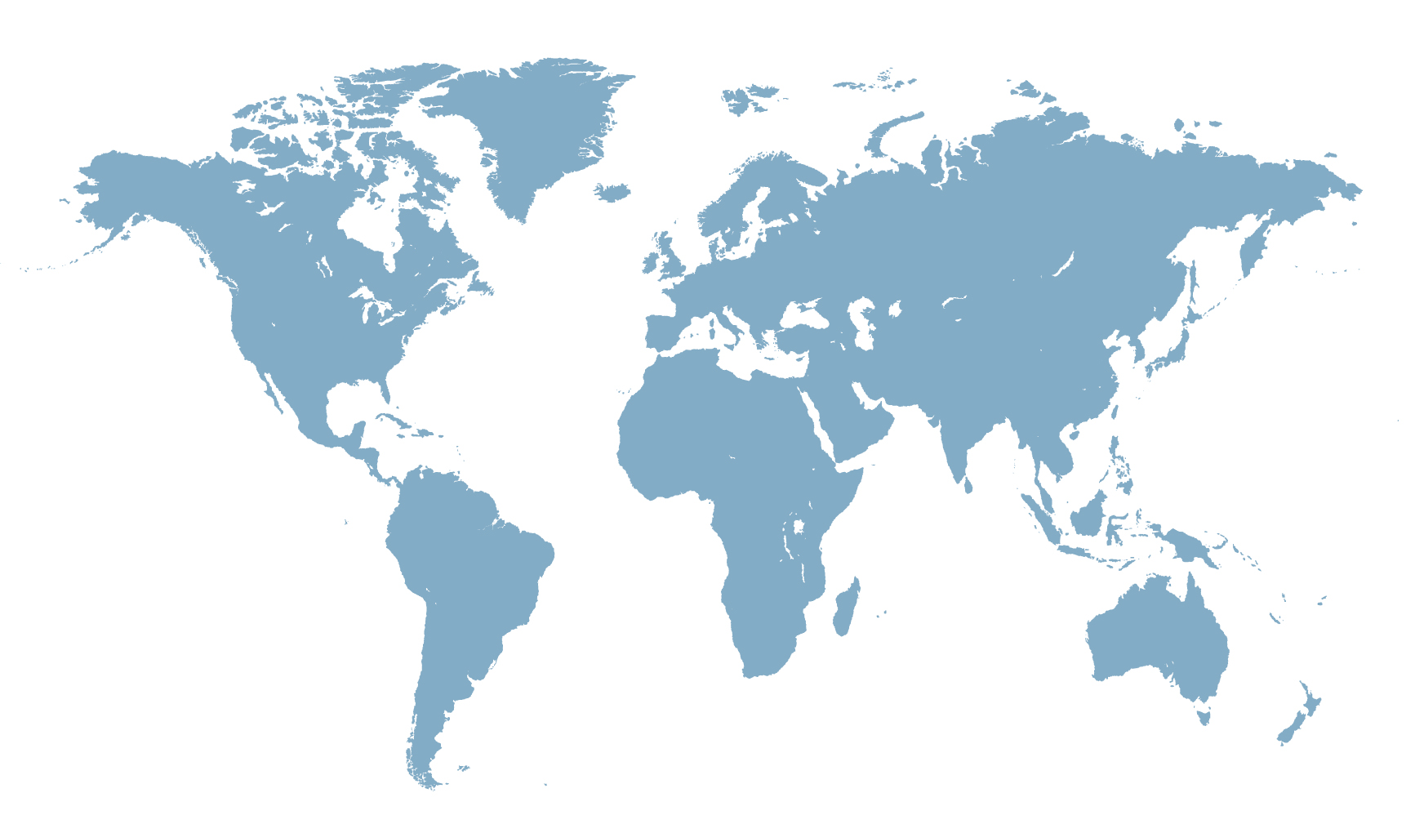
Prescribing by INN:
Encouraged, even Required in Much of the World
  REQUIRED by NRAs in China, Colombia, Latvia.
  ENCOURAGED by NRAs in India, Netherlands.
  PROPOSED as requirement in Russia.
  In many countries, it is at the DISCRETION of the prescriber whether to use INN or brand name.

Slide 15
European Prescriber Survey: Reporting Adverse Events
17% report only the INN.
Identical INN for two different medicines can result in pooling of adverse events, false attribution and other difficulties.

Slide 16
European Prescriber Survey: Batch Number Inclusion
27% of prescribers
NEVER include.
33% only SOMETIMES include.
40% ALWAYS include.
“How often do you include the batch number when reporting adverse events?” (N=470)

Slide 17
A Global Solution to a Global Problem
Current “patchwork approach” of each NRA developing its own system is not adequate.
The WHO’s proposal for a distinguishable INN via Biological Qualifier for biosimilars represents significant progress toward a naming system that will increase safety for all patients.
The time is right: there are relatively few approved biosimilars so far, and biologics comprise 40% of INN applications. The challenge will only grow over time.
NRAs that have substantial regulatory experience with and scientifically sound approval standards for biologics should lead in the adoption of a global solution to pharmacovigilance, starting with product naming.
Our data shows that distinguishable INNs are important to the practicing physicians of Europe, and it is our hope that this will be useful in crafting a global standard that will improve safety for patients worldwide.

Slide 18


